Slide 1
CSS-Bootstrap
Module3_Assignment

Slide 2
Webpage's Component
index.html: main html file
style.css: css file
bootstrap

Slide 3
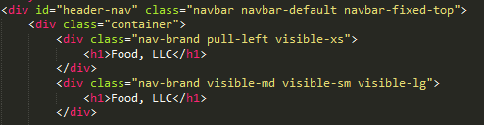
Header
Navbar fixed to the top of webpage when srcolling down
Navbar float to the left then the screen is extra-small
for large, medium and small screen, the navbar displays normally

Slide 4
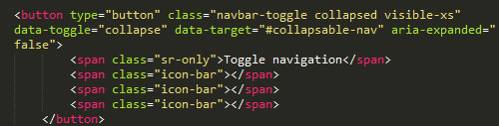
Header-Dropdown button
Dropdown menu only visible when screen-size is small.
A 3-bars dropdown button

Slide 5
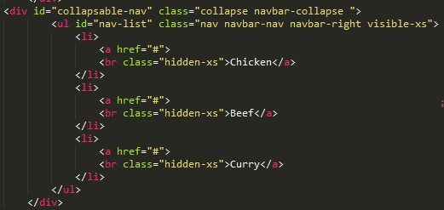
Header-Dropdown button(2)
A default bootstrap collapsable menu
Only visible at extra-small screen

Slide 6
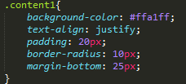
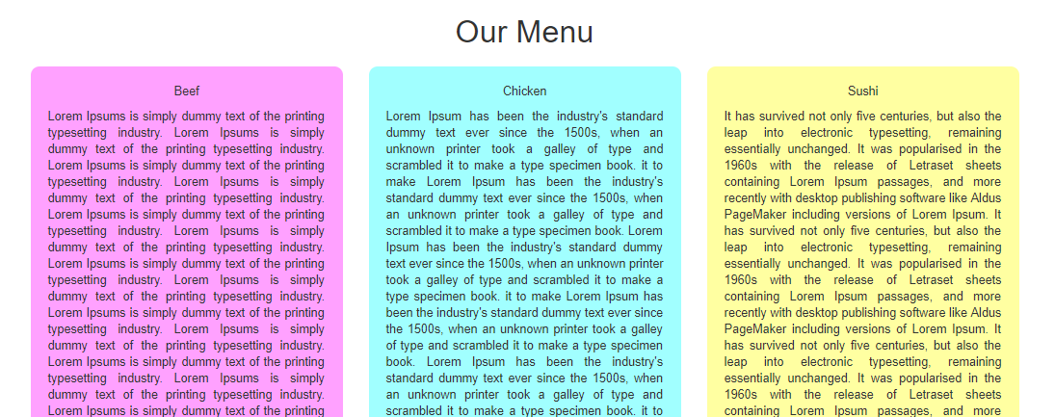
Main contents
Texts will fill the content's width
Some space between each block
Make the edge curvy

Slide 7
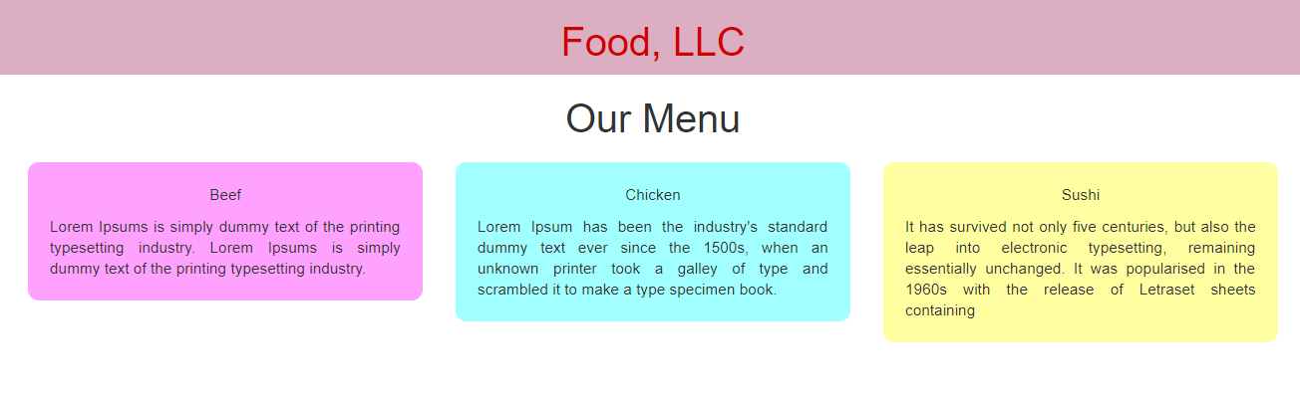
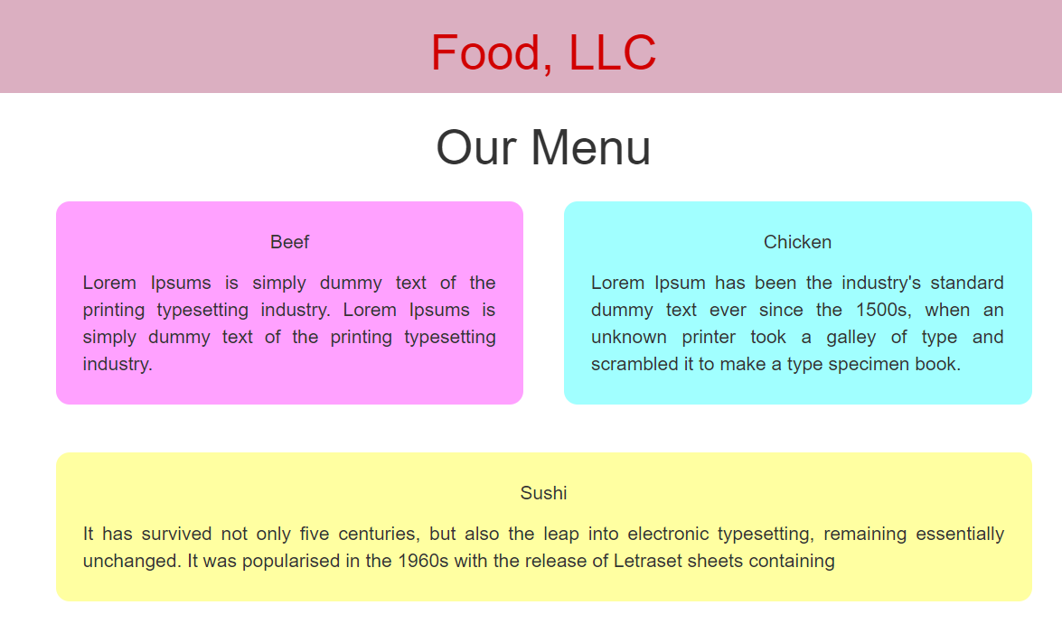
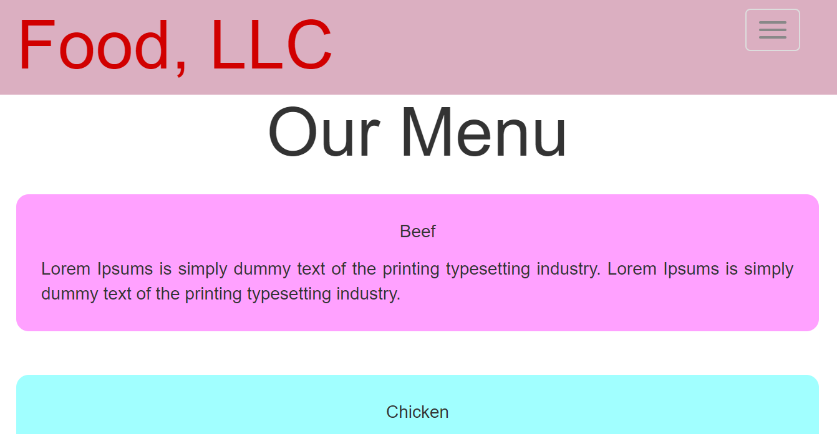
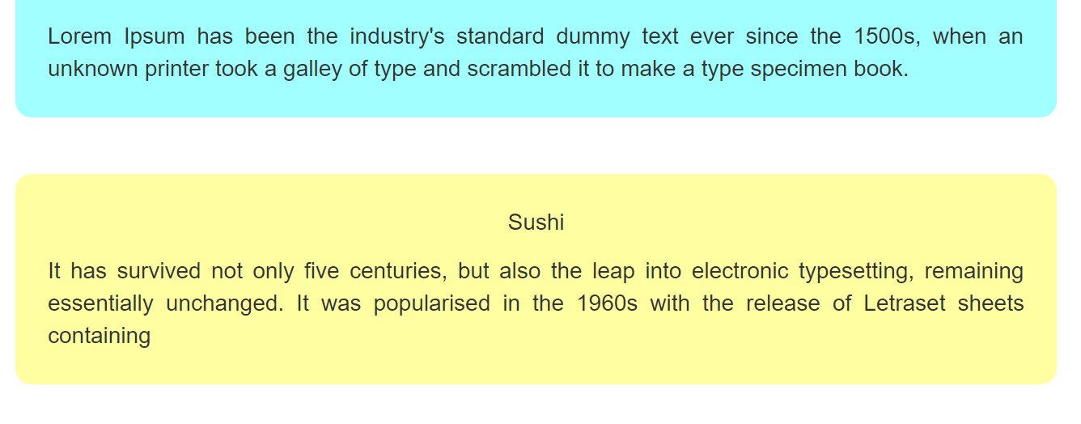
Main contents(2)
Collapsable menu button appears at small screen
Contents floats to the left side
contents stacking upon each other at small screen
3 columns at large screen
2 columns at medium screen

